Slide 1


Friction Stir Spot Welding of Dissimilar Metals and Thicknesses
Department of Mechanical Engineering
Presented by:
Project Guide:
K. Pranay Teja (19951A0337)
R. Karthik (20955A0311)
P. Karthik (19951A0318)
Mr. C. Labesh Kumar

Slide 2
Context of the Presentation
Abstract
Literature survey
Introduction
Materials used
Dimensions of the material
Pictures of the tool with star profile
Tool before and after Hardness
3D modeling of the tool
FSSW Procedure and Prototype
Current status of the project and way forward
References

Slide 3
Abstract
Friction stir spot welding has proved very effective to join dissimilar materials with different thickness. This process is widely used for different alloys like aluminum, copper, magnesium, and steel, but it is hard to conduct on very tough materials with high thicknesses, like titanium and stainless steel. Investigation has been carried out to find the effect of different parameters such as RPM, plunge depth and dwell time to join two dissimilar metals. An effort is made to join the structural steel ST1020 and AL6062 with different thickness with D3 Steel Star profiled tool having three different levels. Mechanical properties are found with respect to tensile test. ANOVA is performed to find out the significant factor contribution. Optimization for the levels of parameters is done to find the best combination of levels.
Keywords: AA6062, ANOVA, Dissimilar metal, FSSW, D3, Star Profile tool, ST1020.

Slide 4
Literature survey
There are different types of friction welding. One of its types is friction stir spot welding. Many research and investigations were carried out on FSSW with the help of tool with probe and tool without probe. Sometimes the tool probe with different profiles was also used for investigations and research. This literature review contained the work carried out by different researchers and authors on FSSW are as :
Friction stir spot welding of Al6062/St1020 metals with dissimilar thicknesses (Published Online: 05 February 2021), by C. Labesh Kumar, G. Bharathiraja, V. Jayakumar. My project is based on this journal and an extension to this journal.
Shear strength optimization for FSSW AA6060-T5 joints by Taguchi and full factorial design (30 November 2020), by C.A.G. Aita, I.C. Goss, T.S. Rosendo, M.D. Tier, A. Wiedenhoft, A. Reguly. This paper gives us the information about the stress analysis and the shear strength in FSSW.
Dissimilar Friction Stir Welding of AA2024 and AISI 1018: Microstructure and Mechanical Properties (14 February 2021) by Md. M. Z. Ahmed, Nabil Jouini , Bandar Alzahrani, Mohamed M. El Sayed Seleman and Mohammad Jhaheen. This paper will provide the information about the FSSW of dissimilar metals.
Development of friction stir spot welding windows for dissimilar Al5086/C10100 spot joints (2017), by S. Siddharth, T. Senthil kumar. This paper gives the information about the FSSW of dissimilar metals and dissimilar thicknesses.

Slide 5
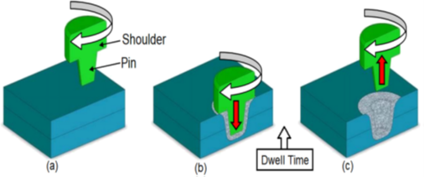
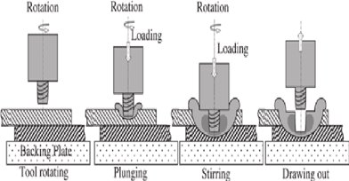
Introduction
Welding of dissimilar metals is the requirement for today’s industry with a good strength to weight ratio.
FSSW is joining process where the joining takes place in three stages plunging, stirring at plunge position and retrieving.
Plunger tool is rotated at high speed on the work material at the spot where as in dwelling makes penetration at that spot with high rotational speed to a certain time and lastly retrieves the tool back to make the spot area cool. It is observed in many cases that FSSW is giving good strength with compared to Resistance Spot welding as shown in figures - 1 & 2.
Much work is carried out on aluminium and its alloying materials, copper and magnesium etc., But on steel a lighter side of work is carried out with dissimilar thickness.
From many literatures and previous works it has been found that very minute work has been carried out on dissimilar metals that to aluminium and steel.
An attempt is made to join these materials with help of tool steel as a tool material by varying process parameters such as work material thickness, tool rotational speed and dowel time to get good tensile strength from the joining with optimizing this parameters using Minitab software. Second bullet point here Third bullet point here
(figure - 1)
(figure - 2)

Slide 6
Materials used for the project
AL6062 : ALUMINUM 6062 is a magnesium silicide type of wrought aluminum alloy having good mechanical properties combined with high resistance to fresh and salt water corrosion. It responds to age-hardening heat treatment.
Structural steel ST1020 : Is an alloy steel with hybridized finish coat of polysiloxane and acryl resin with excellent weather resistance , color and gloss retention. It also displays good resistance to chemicals, solvent, sea water and provides extended lifetime of exposed parts.
D3 steel: D3 steel, also known as 1.2080 (Werkstoff), is an air hardening, high-carbon, high-chromium tool steel. It displays excellent abrasion/wear resistance and has good dimensional stability and high compressive strength. It is heat treatable and will offer a hardness in the range 58-64 HRC.

Slide 7
Friction Stir Welding Applications
1- Friction stir welding can be used in aerospace industry on many parts such as fuselages,
wings, empennages, and fuel tanks for space vehicles.
2- Shipbuilding and marine industries can use the friction stir welding method to join parts
such as sides and panels for decks, bulkheads, and floors.
3- Friction stir welding can be used in railway industries for rolling stock of railways, high
speed trains, underground carriages, and building of container bodies.
4- Friction stir welding can be used in the electrical industry for electrical connectors and
electric motor housings.
5- Some alloys that are welded by this type of welding can be used in the construction
industry and the chemical industry and for aluminum reactors for power plants.
6- Friction stir welding can be used for alloys that have high strength, which can be used
as armor.
7- Friction stir welding joints can be used in land transportation for automotive engine
chassis, truck bodies, and wheel rims.

Slide 8
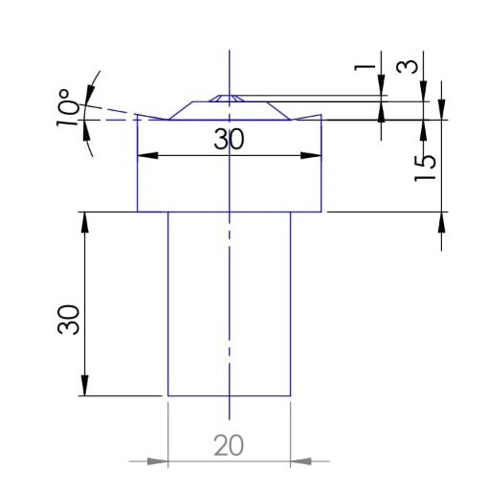
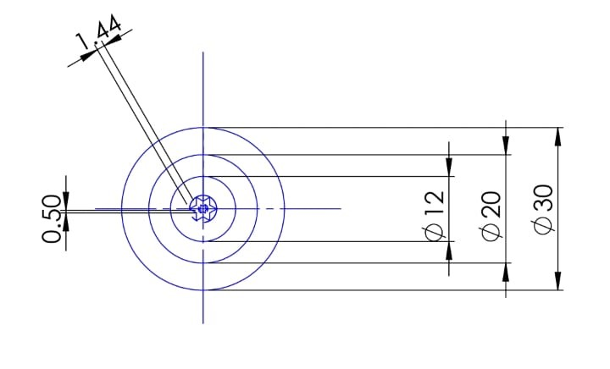
Dimensions of the materials
The work material used for welding is Al6062 and ST1020 with different thickness. 0.5mm, 0.7mm, 0.9mm and combination of this thickness were used. This material is cut into size of 150 mm in length and 20 mm width.
The lap position for overlapping is made. The tool tip is hexagonal profile. Tool material being M2 steel is heat treated above it's recrystallization temperature to achieve high strength The structure of the tool is shown below fig with lap configuration diagram. The aluminium is placed on the top and steel at the bottom of lap.
Dimensions and the design of the tool bit are as followed:

Slide 9
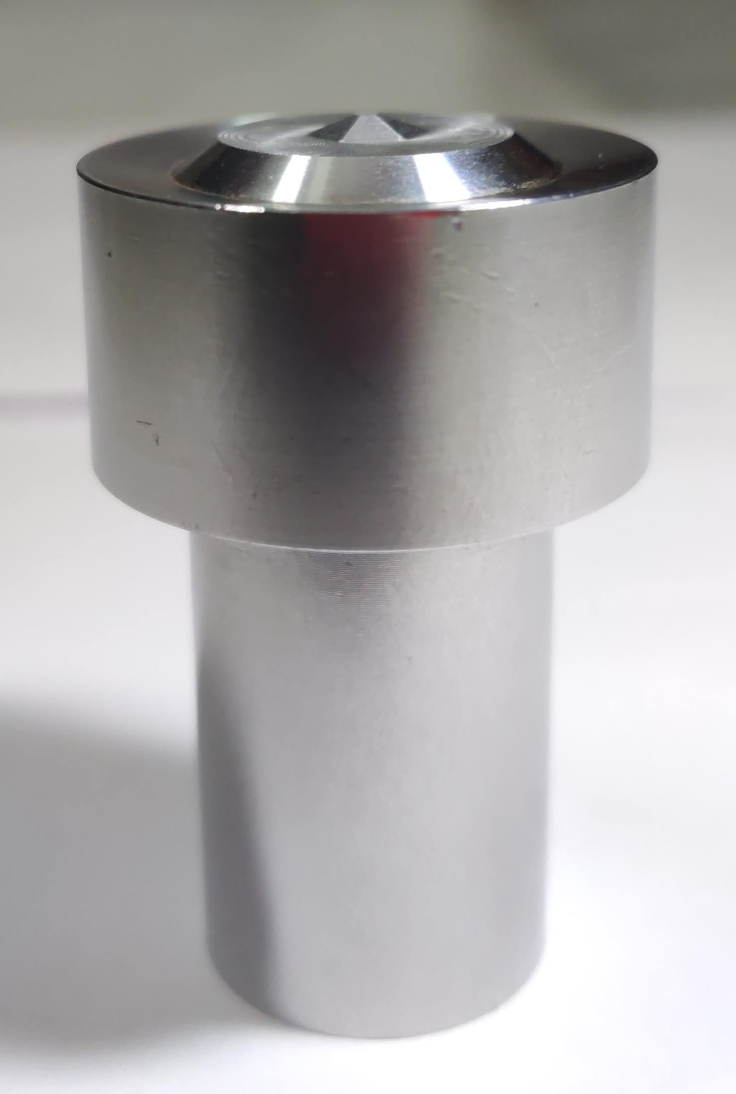
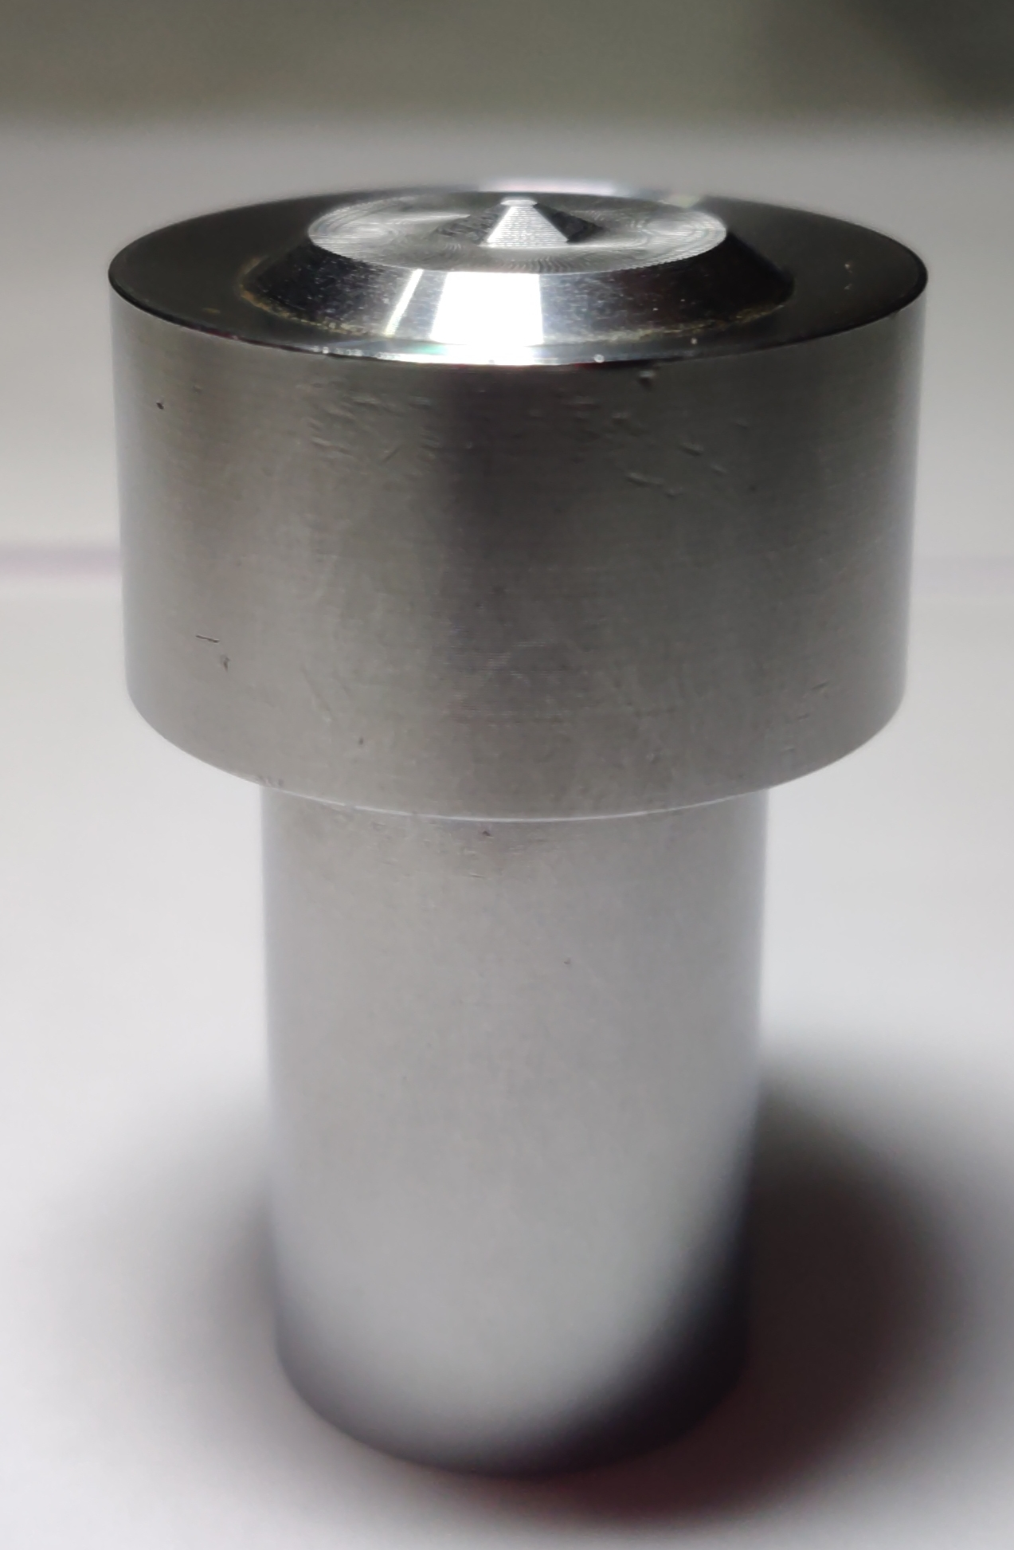
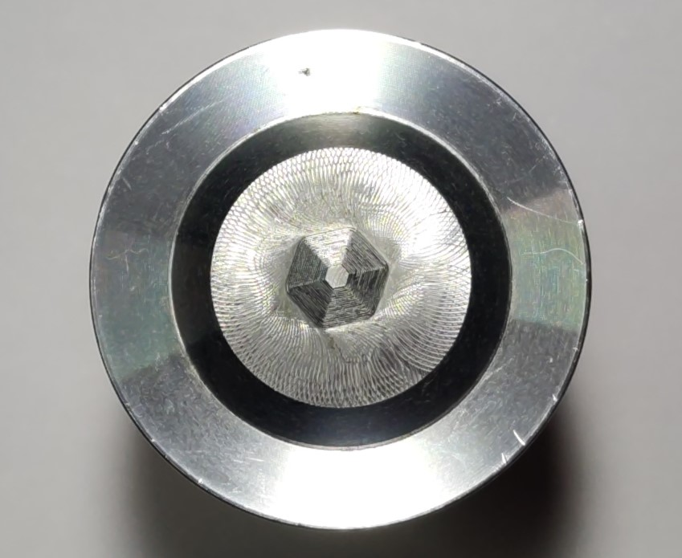
Pictures of the Tool Bit with Star Profile
Tool Bit Top View
Tool Bit Side View 1
Tool Bit Side View 2

Slide 10

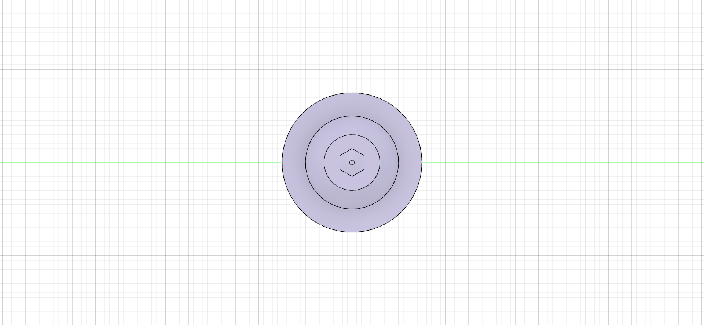
3D Modeling of the tool in Fusion 360
Front View
Top view

Slide 11
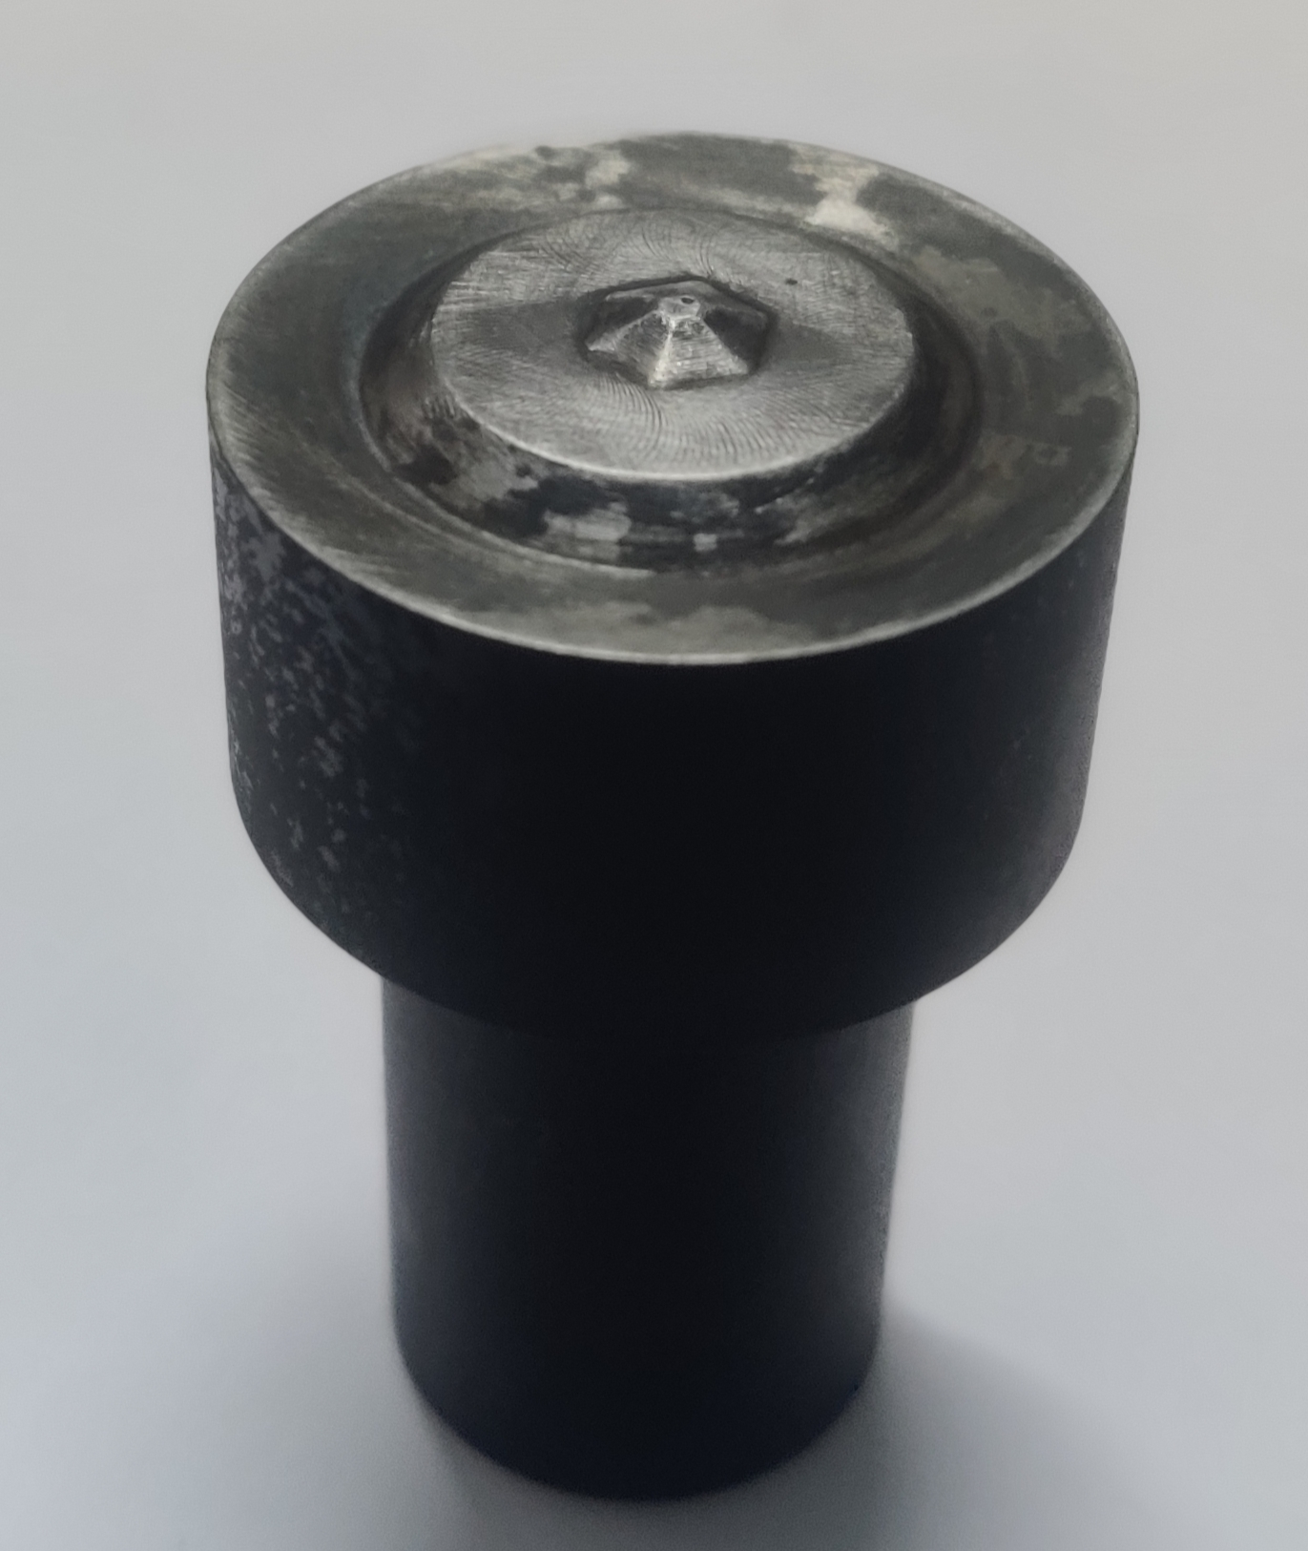
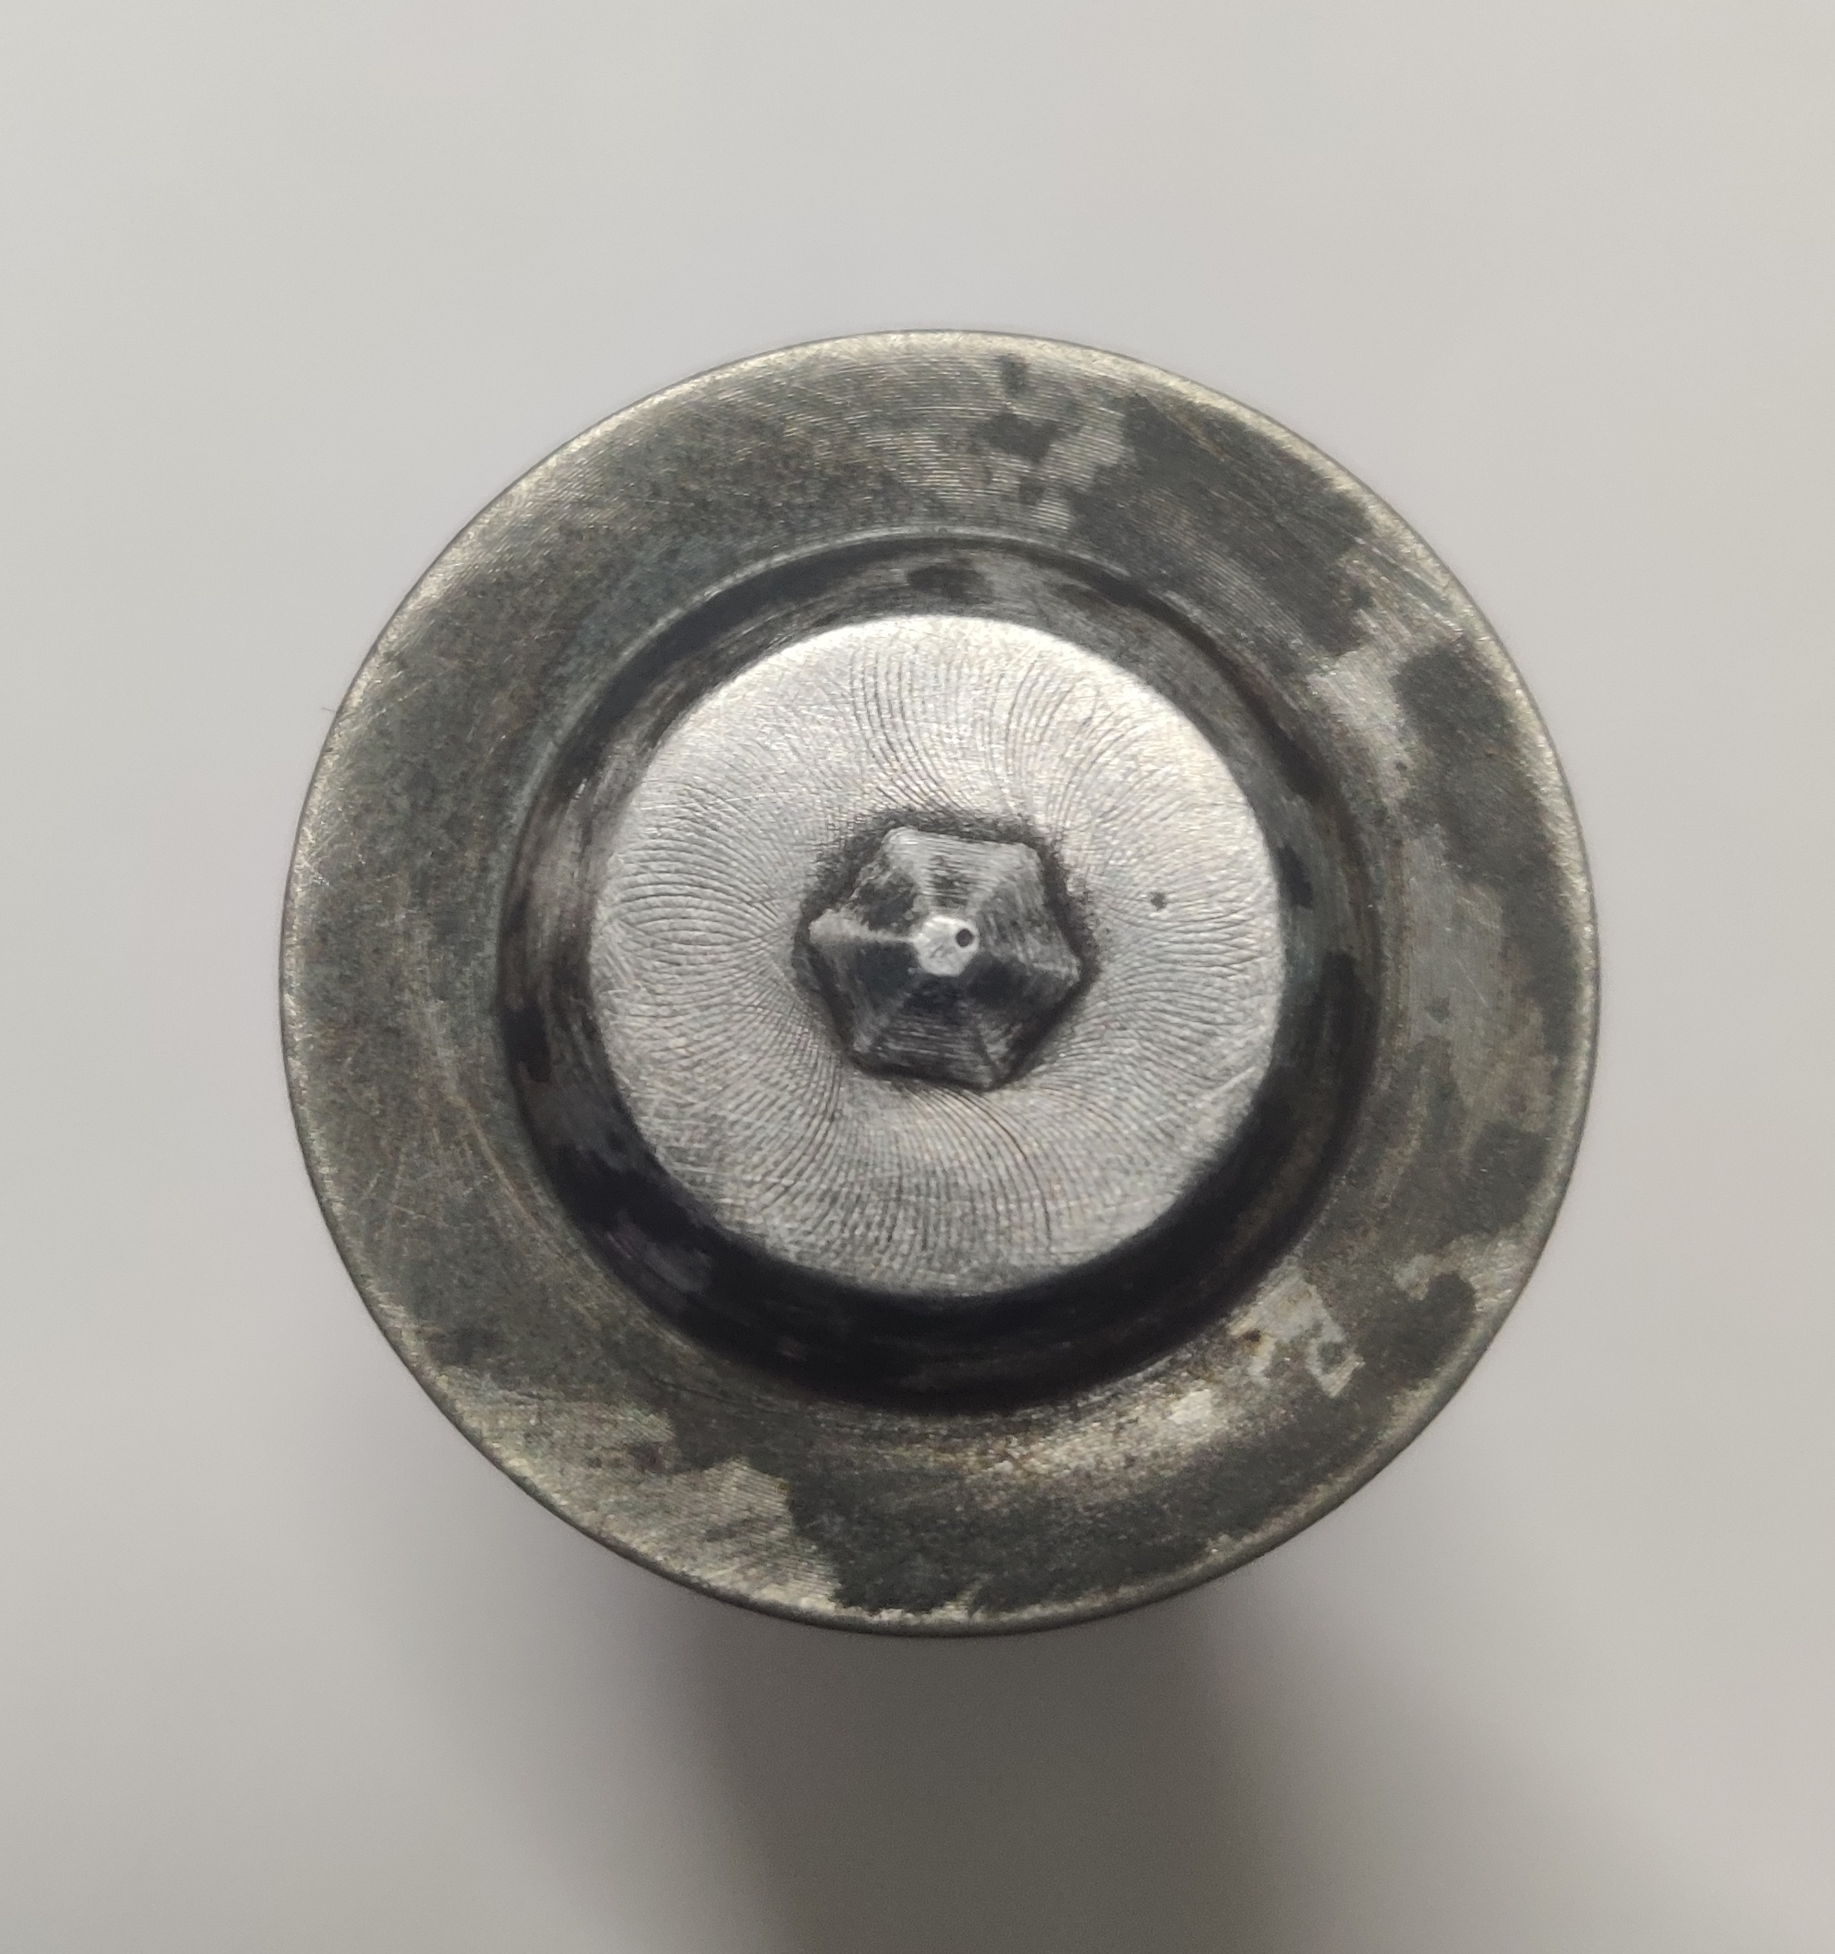
Tool before and after Hardness
Before
After
Brinell Hardness - 63 HRC
Brinell Hardness - 69 HRC

Slide 12
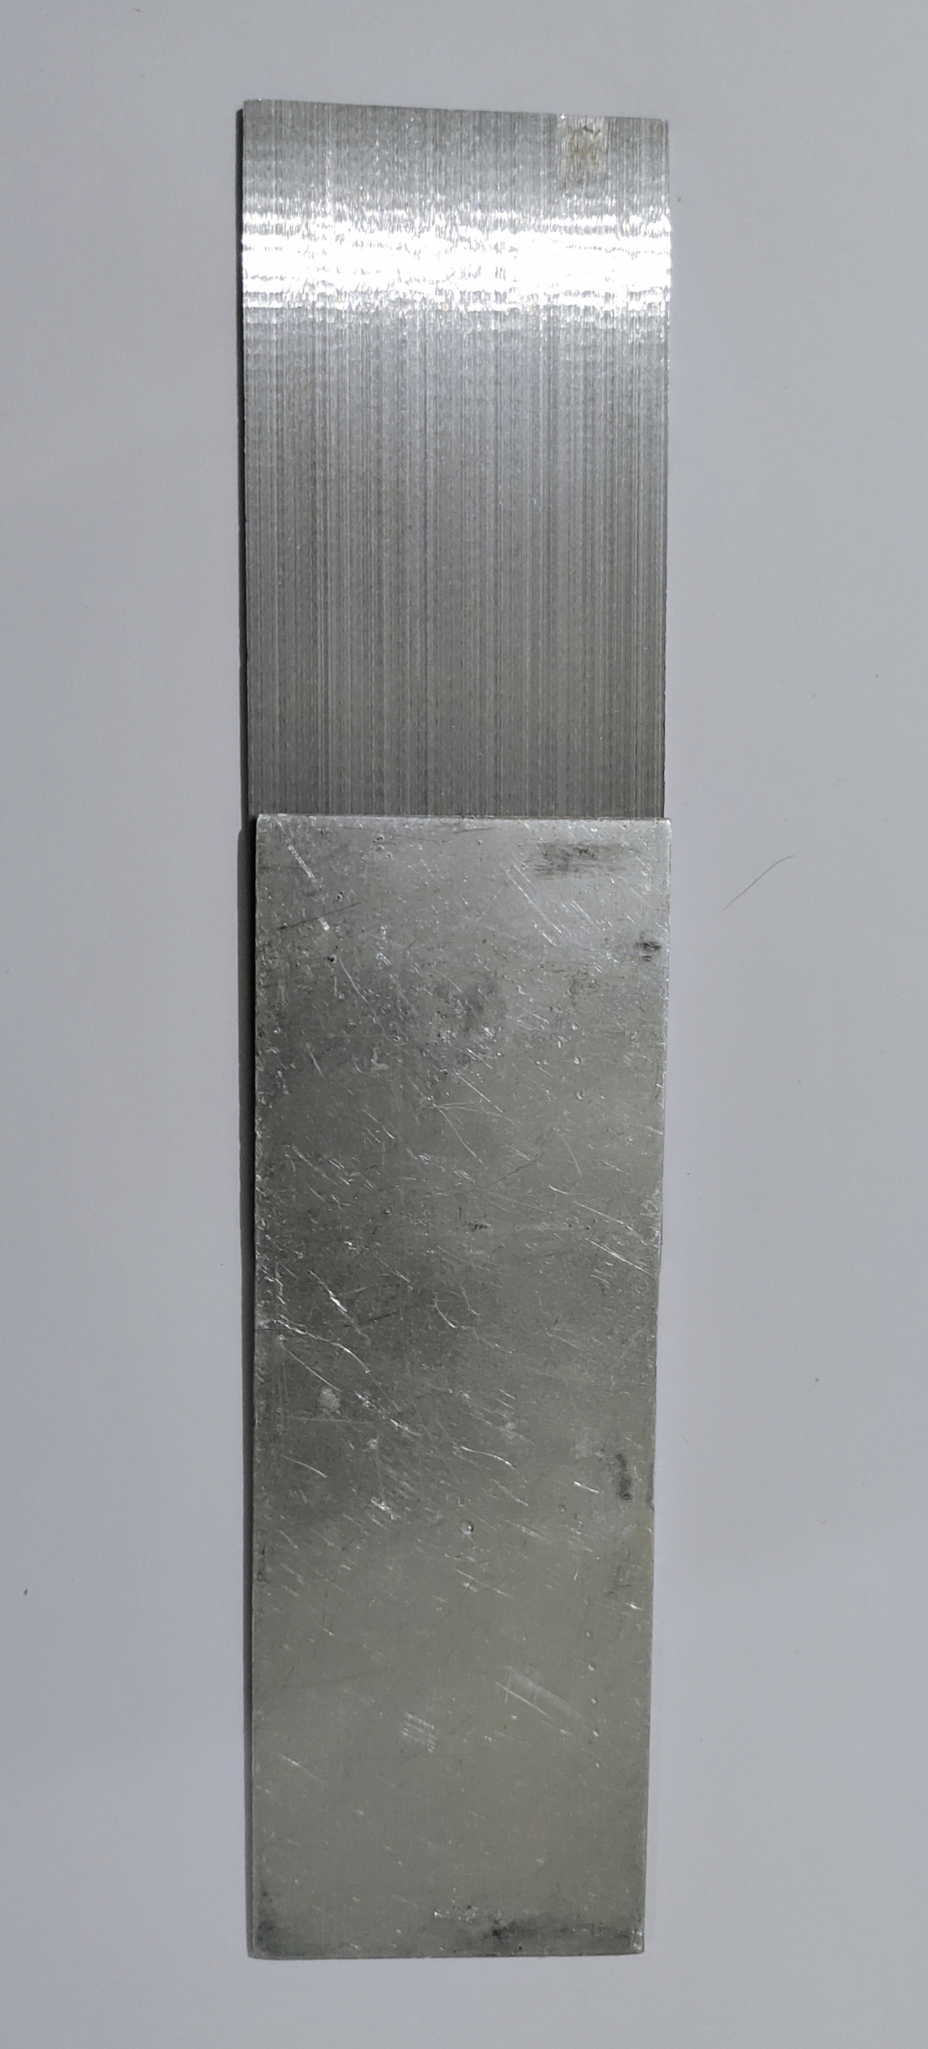
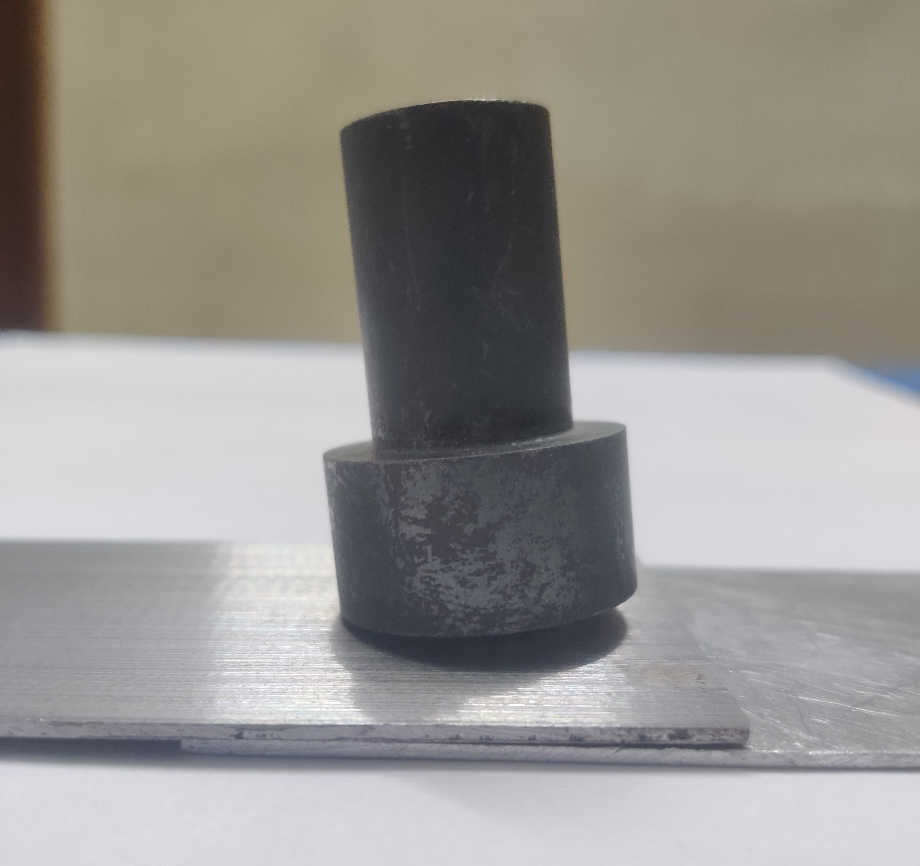
FSSW Procedure and Prototyping
We reduced the thickness of the steel sheet using the surface grinding machine.
We place the Aluminium on top of Steel plate like a lap joint.
After placing the lap joining we perform the FSSW and join the dissimilar metals.
We are performing this operation using the Drilling machine in our college.
We fix our tool it to the drilling machine and place the metal sheets in the lap joint position and perform FSSW.

Slide 13
CONCLUSION
We did Friction Stir Spot Welding of two dissimilar metals, AL6062 and ST1020, of various thicknesses, say 1.5mm and 3mm, in this project, and the results are shown. To unite these metals, a tool composed of D3 tool steel is utilized. Three factors for metal joining are selected at three separate levels: tool speed, dwell duration, and plunge depth. Friction Stir Spot Welding was done on an FSSW machine, and the values were computed and studied thoroughly. To verify the generated joint utilizing the welding technique, design of experiments is used; ANOVA is done for larger the better value. The Taguchi Method was utilized to optimize the FrictionIStirISpotJWelding process parameters. The following graphs were created using the Minitab software: Main effects plots for means and SN ratios have been produced, and the following tables have been obtained: response table for signalItoInoise ratio, response table for means, and response table for SNRA1. As a consequence, there is a fact that demonstrates that using these would result in an enhancement as well as a solution for the advancement in the future.

Slide 14
References
C. Labesh Kumar, G. Bharathiraja, and V. Jayakumar Friction stir spot welding of Al6062/St1020 metals with dissimilar thicknesses, Cite as: AIP Conference Proceedings 2317, 020036 (2021); https://doi.org/10.1063/5.0036200 Published Online: 05 February 2022.
S.Siddharth, T . Senthil kumar” Development of friction stir spot welding windows for dissimilar Al5086/C10100 spot joints” Materials Today: Proceedings 5 (2018) 6550–6559.
Mukuna P. Mubiayi, and Esther T. Akinlabi, “Friction Stir Spot Welding of Dissimilar Materials: An Overview”, Proceedings of the World Congress on Engineering and Computer Science 2014 Vol II WCECS 2014, 22-24 October, 2014, San Francisco, USA.
G.K Padhy, C.S Wu, S.Gao , “Friction stir based welding and processing Technologies processes, parameters, Microstructures and applications: A review”, Journal of Material Sci. and Technol. 34 (2018) 1-38.
S. Joy-A-Ka, Y. Ogawa, A. Sugeta, Y.F. Sun and H. Fujii, “Fatigue Fracture Mechanism on Friction Stir Spot Welded Joints Using 300 MPa-Class Automobile Steel Sheets under Constant and Variable Force Amplitude”, Procedia Materials Science 3 (2014) 537–543.
F.C. Liu, Y. Hovanski, M.P. Miles, C.D. Sorensen, T.W. Nelson, “A review of friction stir welding of steels: Tool, material flow, microstructure, and properties”, Journal of Material Sci. and Technol. 34 (2018) 39-57.
Gianluca Buffa, PierluigiFanelli, LivanFratini, Francesco Vivio, “Influence of joint geometry on micro and macro mechanical properties of friction stir spot welded joints”, Procedia Engineering 81 (2014) 2086 – 2091.

Slide 15


